Slide 1

“Shop anytime in the comfort of your home”

Slide 2

R.Camia is an extended partner online
groceries that offers service online.

Slide 3
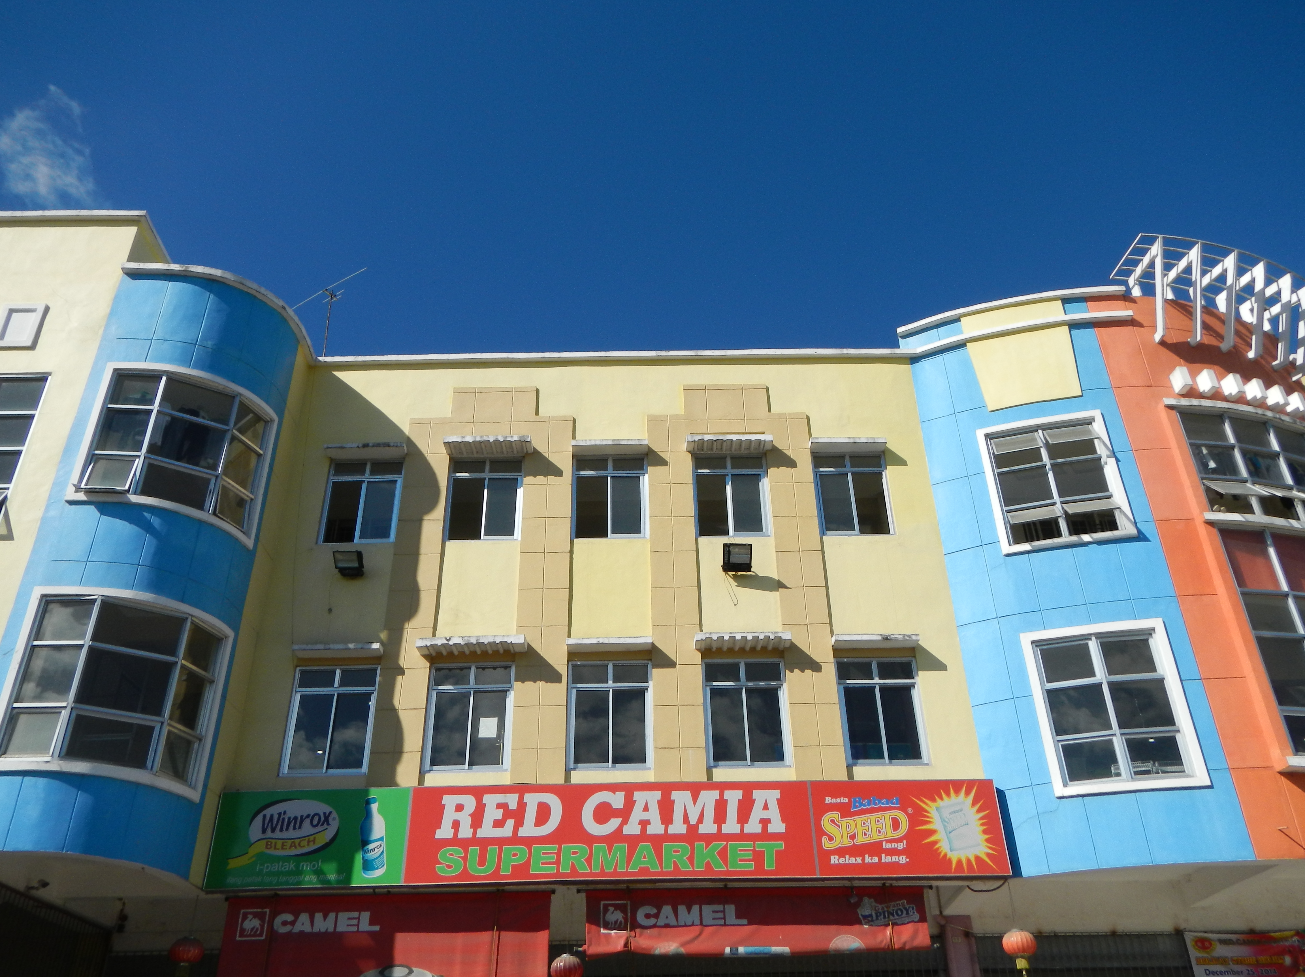
Red Camia

Slide 4
Red Camia Branches:
Arayat, Pampanga
Apalit, Pampanga
Paniqui, Tarlac
Guagua, Pampanga
J.P Rizal Dinalupihan, Bataan

Slide 5
Services and Offers
R.Camia offering discounts, and coupons
Offer product delivery
You have an option to chose a delivery
time that is suitable for you.

Slide 6
Purpose
To save time and money
To make grocery shopping
easy and convenient

Slide 7
Target Market
Has owned at least Paypal account (use for online payment)
The one who do the house chores especially the Mom
Have a busy lifestyle
And have the money to do so…

Slide 8

Mode of payment:
Paypal (online transaction)

Slide 9
Marketing Activites
Advertise it on the Grocery store (physical)
Hosting social media pages

Slide 10
Competitive Advantage
Great customer service online
Offers discounted items
Convenient and highly secured transaction

Slide 11
Revenue model
Sales
Advertising
Transaction fee

Slide 12
Types of E-commerce
Local E-commerce
Business-to-Consumer (B2C)

Slide 13

Web Technology

Slide 14
Thanks be to God!

